Slide 1

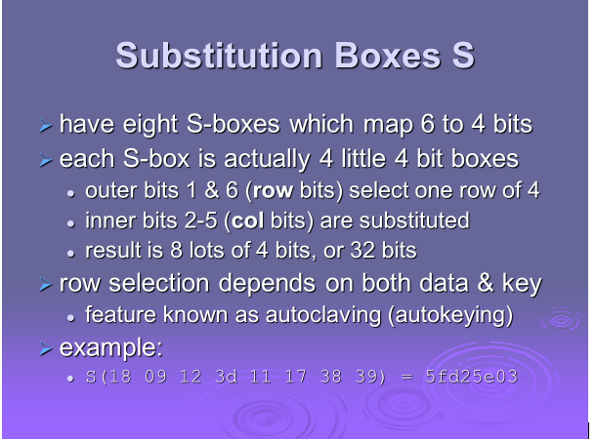
S-BOXES
SOURCE:STALLINGS

Slide 2
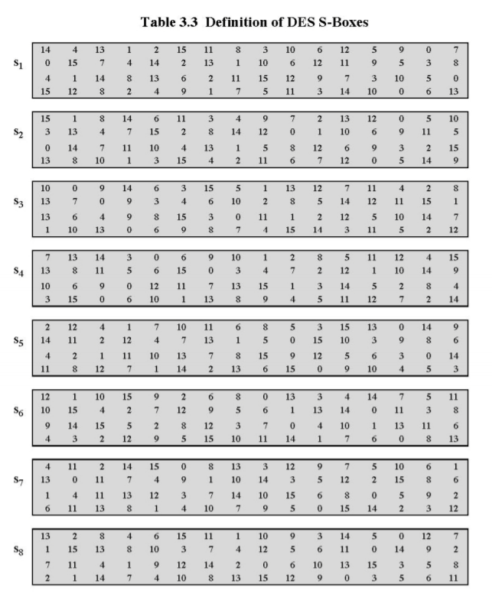
S-BOXES
SOURCE:STALLINGS

Slide 3
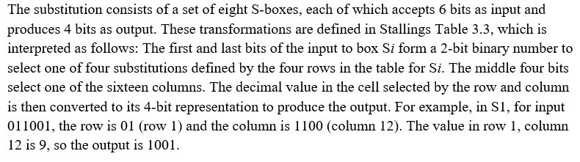
S-BOXES
SOURCE:STALLINGS

Slide 4
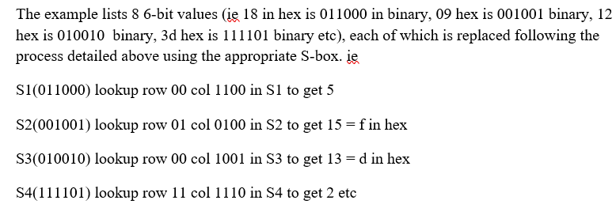
S-BOXES
SOURCE:STALLINGS

